Slide 1

Project Title – Crop Production Analysis.
Student Name: Bishal Naskar
AICTE STUDENT ID: STU65296aabc38b21697213099

Slide 2

PROBLEM STATEMENT
Data Integration: Integrate diverse datasets encompassing crop yield, weather conditions, soil quality, and agricultural practices into a unified platform within Power BI.
Visualization: Develop visually appealing and informative dashboards that present key metrics and trends related to crop production, such as yield per acre, seasonal variations, and comparative analysis across different crops and regions.

Slide 3
Project Description: Crop production is a vital component of global agriculture, influencing food security, economic stability, and environmental sustainability. The "Crop Production Analysis" project aims to utilize data-driven methodologies to analyze various aspects of crop production, including yield prediction, resource optimization, and risk assessment.

Slide 4

WHO ARE THE END USERS?
Farmers
Agriculture Extension Services
Agribusiness
Government Agencies
Research & Academia
Consumers

Slide 5

Technology Used
Power BI Desktop
Power Query Editor

Slide 6
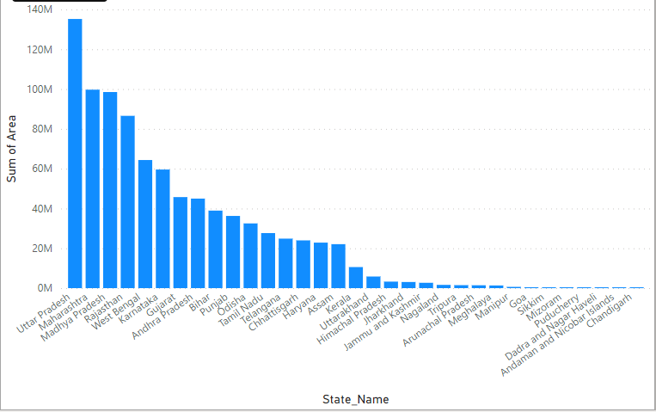
RESULTS
Sum of Area by State Name:

Slide 7
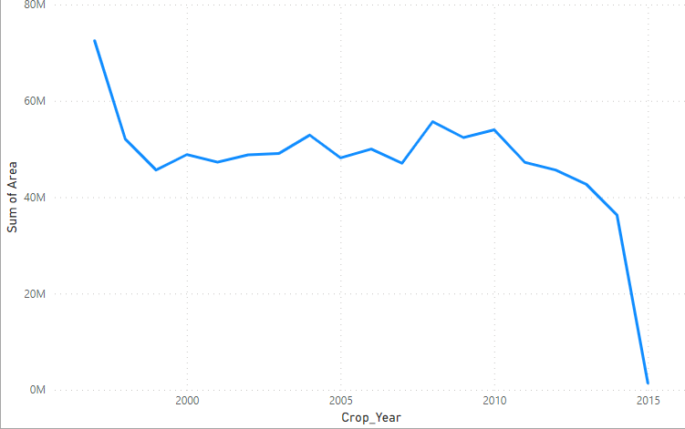
RESULTS
Sum of Area by Crop Year:

Slide 8
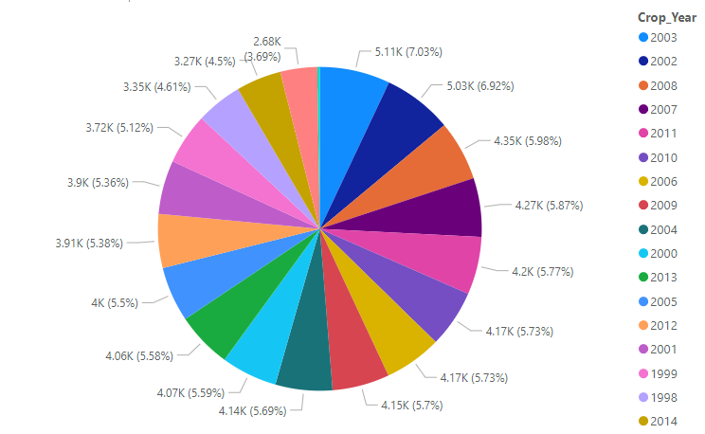
RESULTS
Count of Crop By Crop Year:

Slide 9
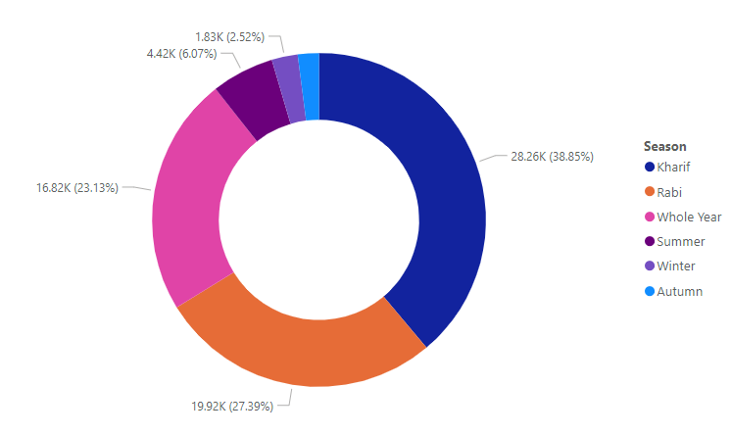
RESULTS
Sum of Crop By Season:

Slide 10
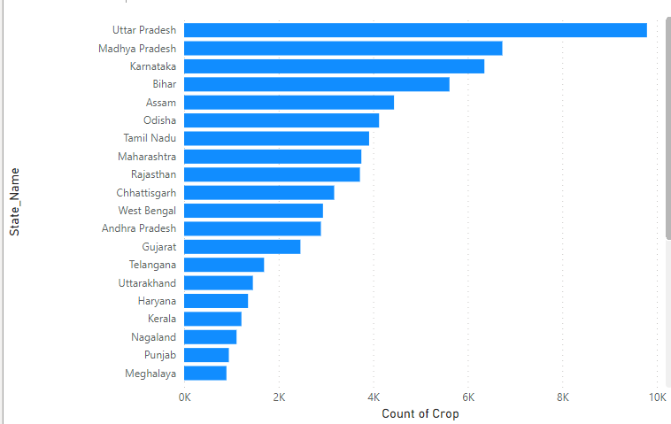
RESULTS
Count of Crop by State Name:

Slide 11
Thank you
In this file I have transformed raw data and visualized some important data. Some of those screenshot of it are attached in this file. Through which we will have many benefits to visualize the data.
.
.

